Slide 1
PROJECT UPSKILL PRESENTS
BUILDING YOUR LINKEDIN BRAND
[DATE OF WORKSHOP]
Presented by: [Insert name]

Slide 2
Project Upskill
LET'S DO AN ICEBREAKER!
What is your most interesting/coolest hobby?

Slide 3
Project Upskill
WHAT IS A PERSONAL BRAND?
"Personal brand is what people say about you when you leave the room."
Jeff Bezos

Slide 4
Project Upskill
SOME ADVICE BEFORE WE BEGIN
Make these changes now! If you don't, you'll probably never do it.
As with all advice, take what you like and leave what you don't.

Slide 5
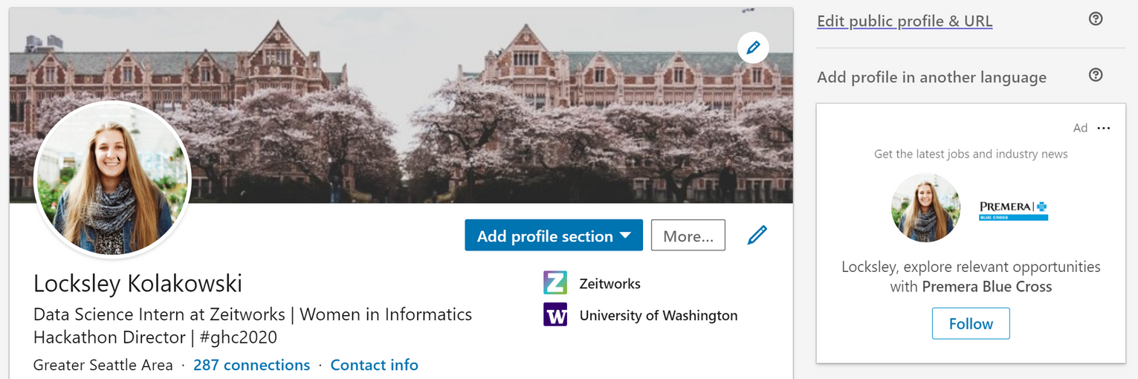
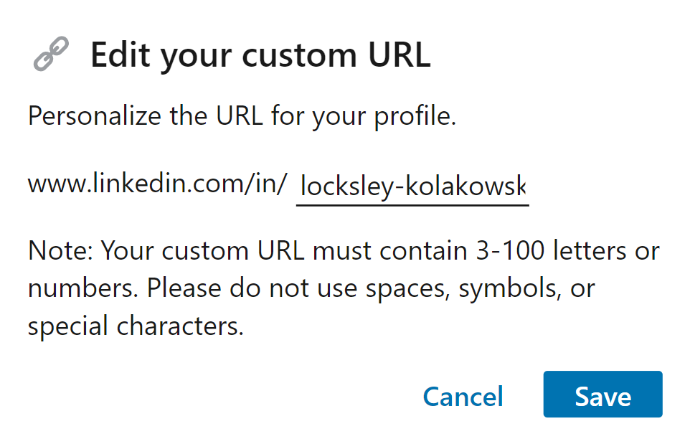
Project Upskill
CUSTOMIZE YOUR URL

Slide 6
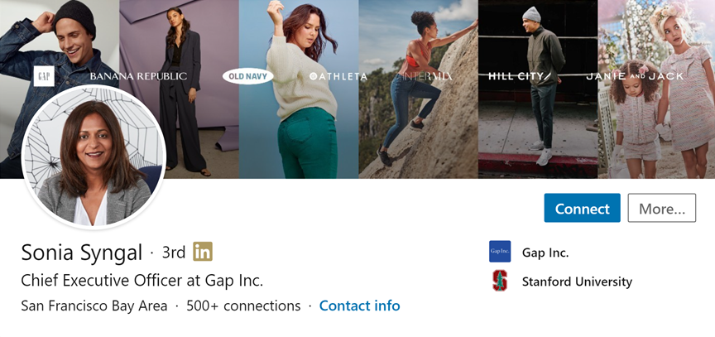
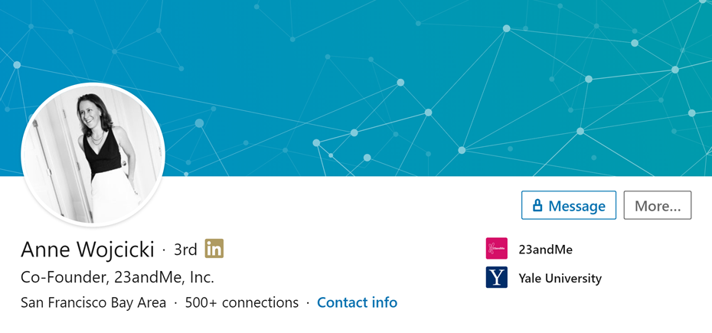
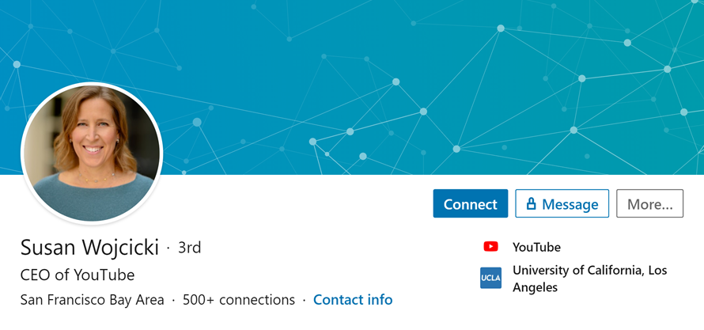
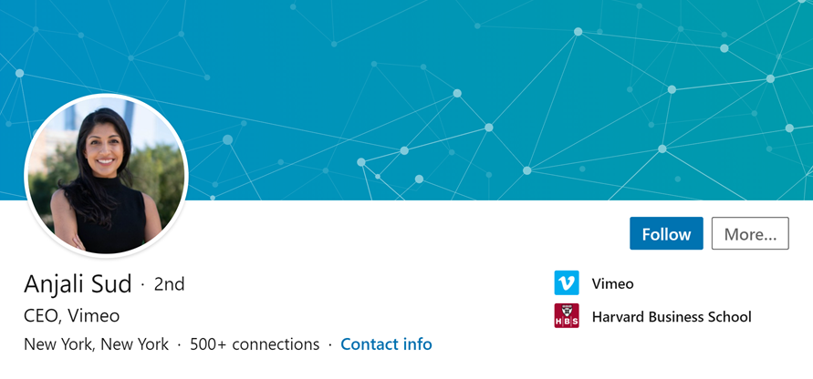
PROFILE PICTURE
Make your photo reflect the industry you want to enter | Avoid cropped photos

Slide 7
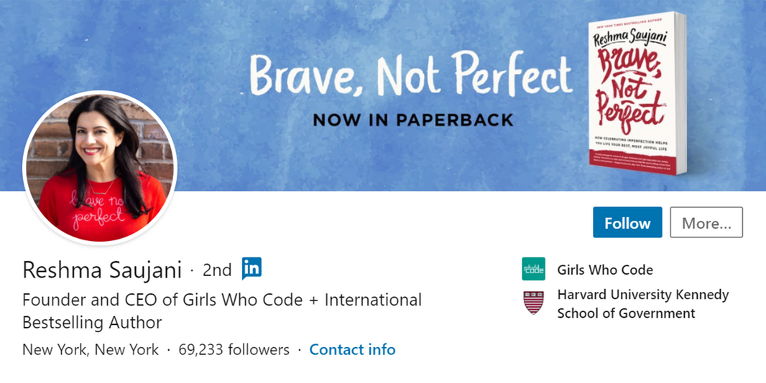
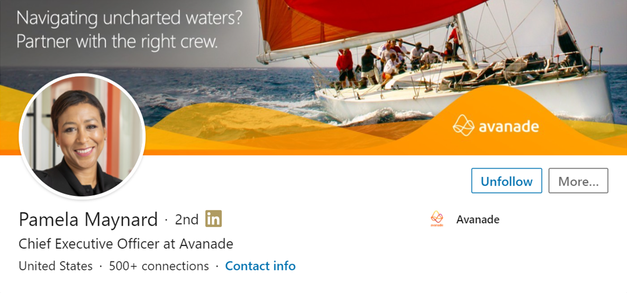
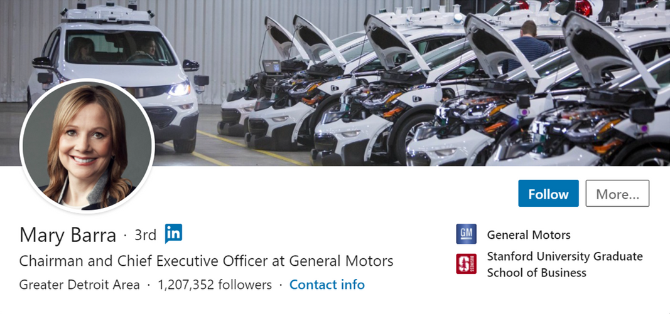
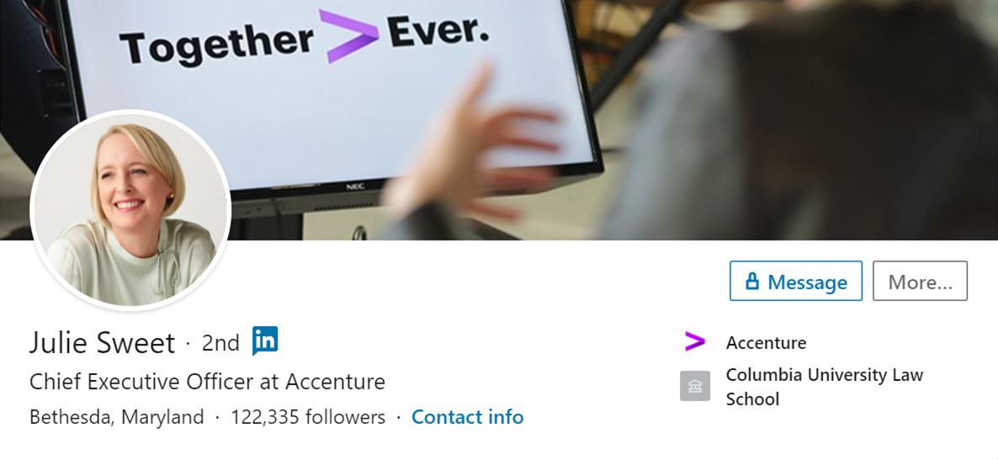
COVER PHOTO

Slide 8
Project Upskill
YOUR NAME
You want your name to be how you introduce yourself
LinkedIn is rolling out a new tool that helps with pronunciation
You want to test it and make sure the pronunciation is accurate

Slide 9
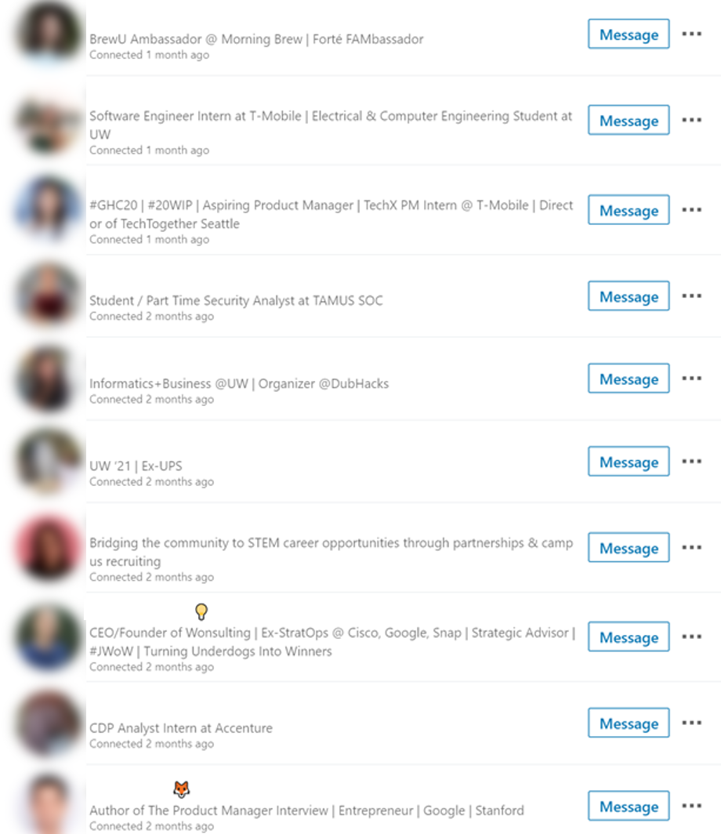
Project Upskill
HEADLINE
Avoid cookie cutter titles
Consider the Search Engine Optimization (SEO)
What you're an expert in | Your passion | Your job title

Slide 10
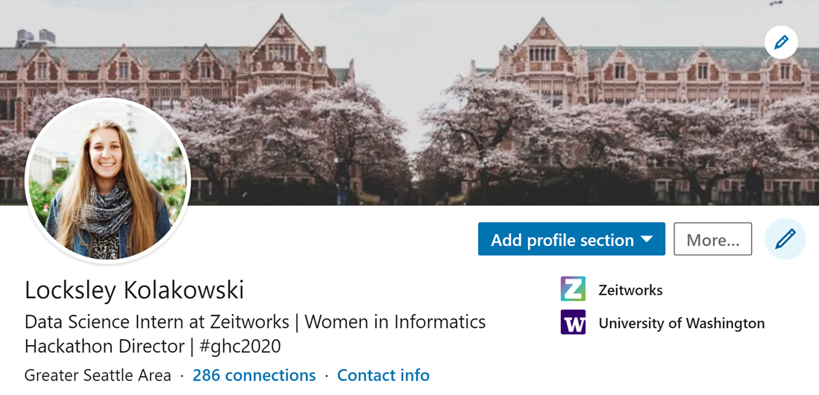
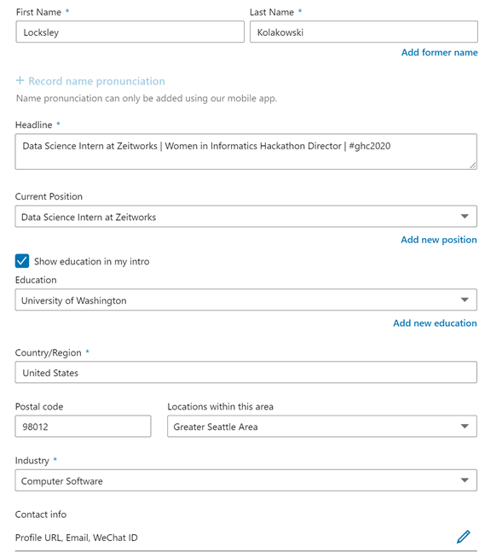
Project Upskill
FINAL CONSIDERATIONS
Make sure your school and work is accurate!
Make sure your location is a place recruiters would know.

Slide 11
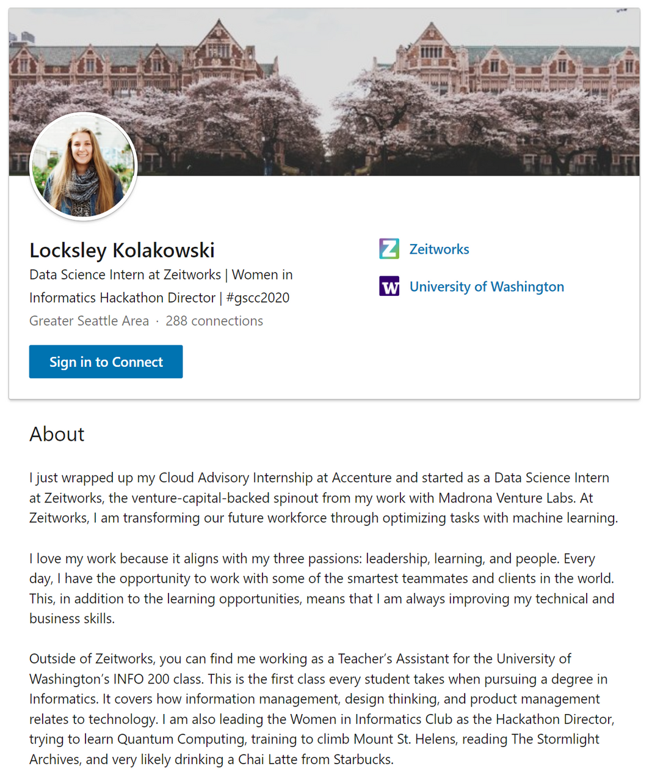
Project Upskill
ABOUT SECTION
What do you do?
What gives you the business to do it?
What has fueled your curiosity to do this work?
What do you like about it?
Who are you outside of work?
Be specific!

Slide 12
LET'S PRACTICE!
What do you do?
I am a student at ... studying ... with a focus in ...
I am a ... intern at ... on the ... team.
What gives you the business to do it?
What has fueled your curiosity to do this work?
What do you like about it?
What does your occupation need to have to make it satisfying?
Leadership? Opportunities for learning and growth? Amazing people?
Who are you outside of work?
Be specific!
Extracurriculars can be both professional and personal! We are more than our profession--this is how you humanize yourself to the world!

Slide 13
SKILLS SECTION
LinkedIn lets you put 50 skills on your profile
Hard skills are better than soft skills
Endorsements are important!
The LinkedIn search algorithm will show people with more endorsements
If you haven't yet, drop your profile into the chat so people can connect/endorse your skills!

Slide 14
Project Upskill
THANK YOU!
Questions?
This event would not be possible without Caitlin Goldbaum, Austin Henline, and Cass McCrory. Thank you!

